Slide 1
Applied Data Science Capstone
Segmenting and Clustering Neighborhoods in Toronto, Canada
-Rishabh Tamhane

Slide 2
Introduction
When a Restaurant Chain plans on opening a chain of restaurants in a city, there are many factors that need to be considered:
1) The most commonly visited category of restaurants in the region.
2) The most optimal locations for setting up the restaurants so that they don't end up competing against each other, thereby reducing the profits of the restaurant chain.
3) The locations of the restaurants the Restaurant Chain plans on competing against so as to avoid cut throat competition against closely clustered restaurants.

Slide 3
Methodology
1) Web Scraping Data about the Neighborhoods in Toronto from Wikipedia
2) Web Scraping Data about the Restaurants in the Neighborhood
3) Cleaning and Organising the Data
4) Exploratory Data Analysis
5) Conclusion

Slide 4
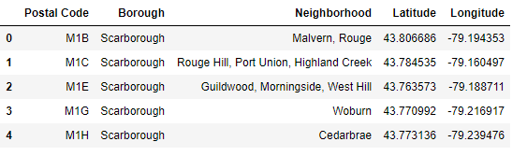
Web Scraping Data about the Neighborhoods
in Toronto from Wikipedia

Slide 5
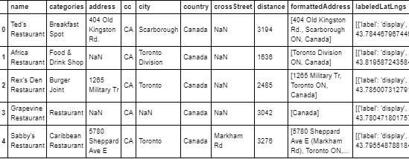
Web Scraping Data about the Restaurants
in Toronto Using FourSquare API

Slide 6
Web Scraping Data about the Restaurants
in Toronto Using FourSquare API

Slide 7
Exploratory Data Analysis

Slide 8
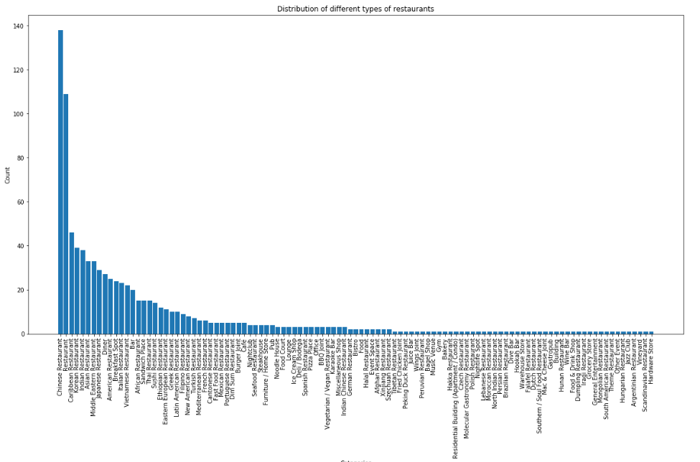
Distribution of different categories of restaurants

Slide 9
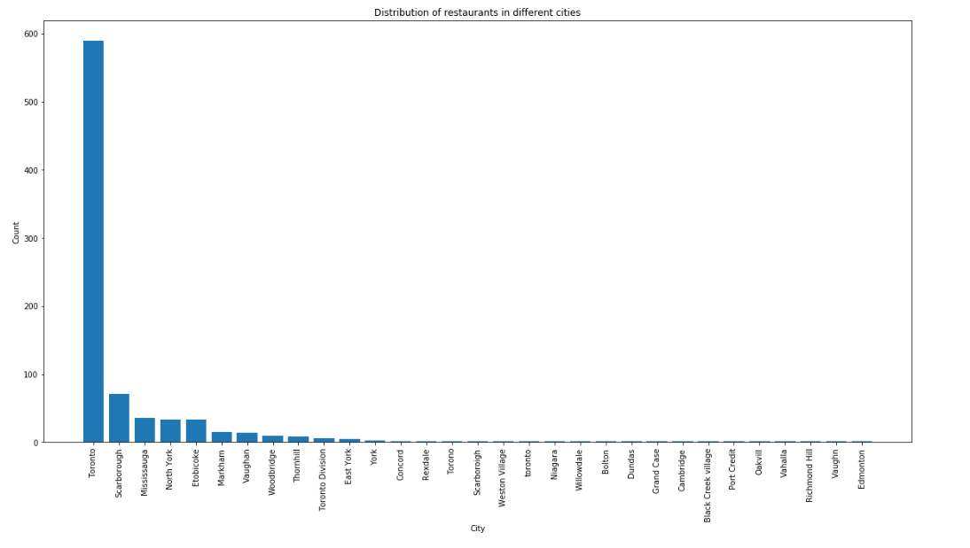
Distribution of restaurants

Slide 10
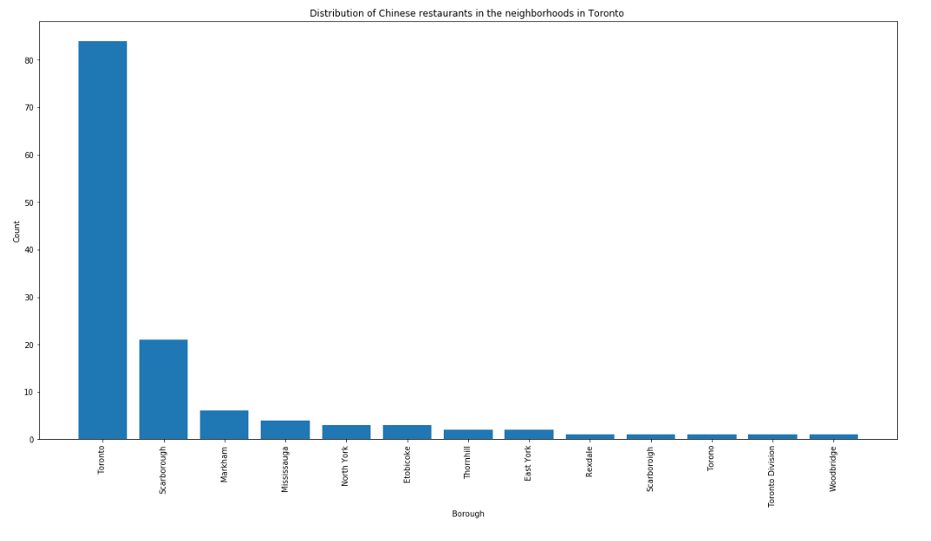
Distribution of Chinese Restaurants

Slide 11
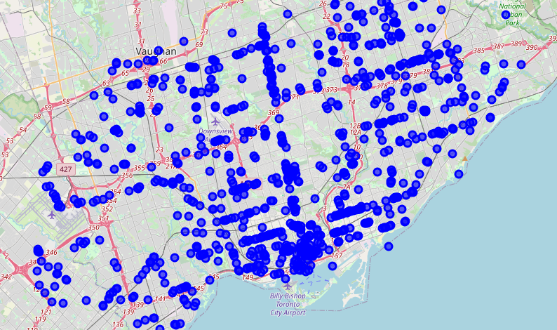
Map Plot of Restaurants

Slide 12
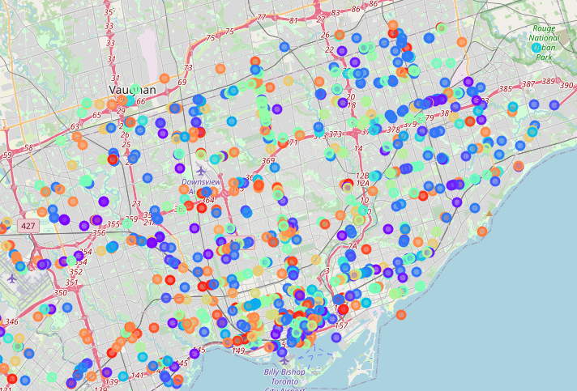
Clustering of Restaurants Based on Categories

Slide 13
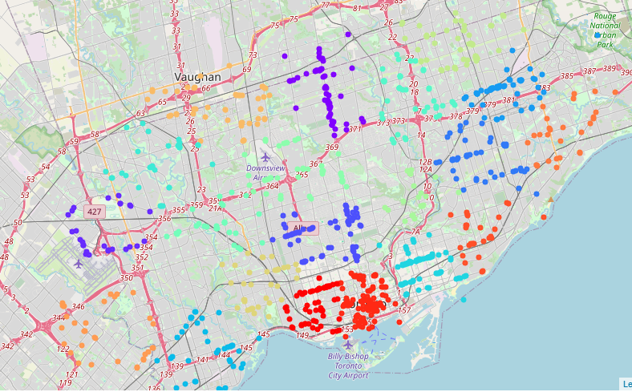
Clustering of Restaurants Based on Location

Slide 14
Problem Statement and Solution
1) Let us say I have a client who is looking to set up a restaurant in Canada. I have to make a recommendation about which is the most common category of restaurants in the neighborhood.
Since, there are 139 Chinese Restaurants, they are the most common restaurants in the neighborhoods.
2) Now the client is planning to set up a chain of 20 Chinese restaurants in and around Toronto. So, I have to make a recommendation about the location of these restaurants so that they don't cannibalise each other
Using K-Means Clustering which is an Unsupervised Machine Learning Algorithm, I clustered the Chinese Restaurants in 20 clusters (as shown in next slide). Now, I can recommend the Restaurant Chain to set up restaurants in each of these clusters, so that while catering to the customers, it will reduce the chances of cannibalisation amongst the restaurants belonging to the same restaurant chain. This approach also ensures that we cover a larger customer base while being aware of the competition prevalent in each area. It also makes sure that more restaurants are set up in the areas where Chinese Restaurants are more commonly visited than other areas.

Slide 15
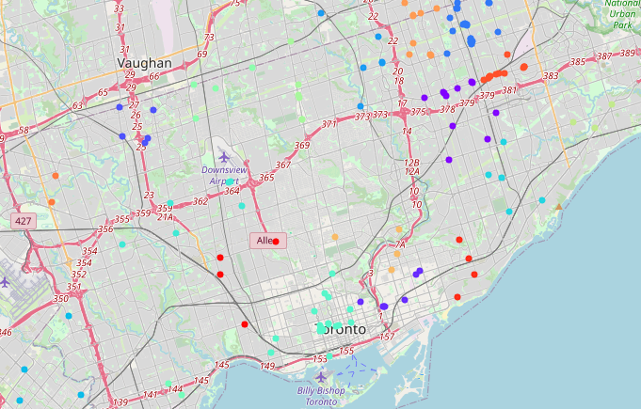
Clustering of Chinese Restaurants Based on
Location

Slide 16
THE END

